Slide 1
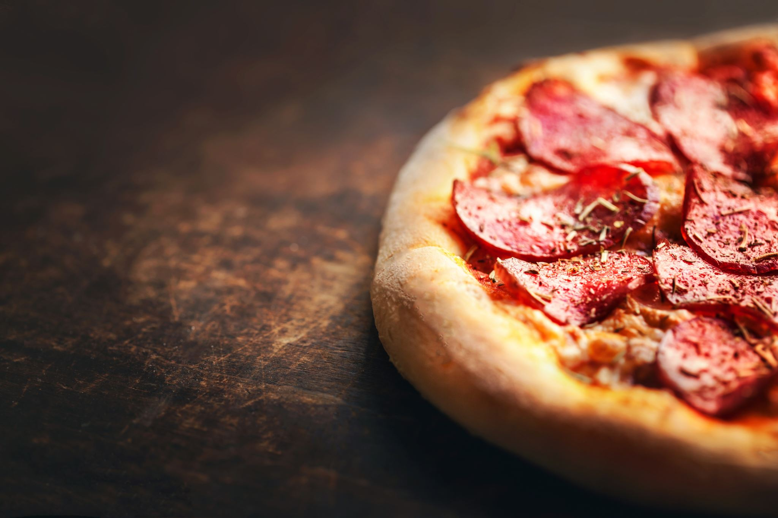

Forecasting Pizza Parlor Sales
By: Jamie Tran

Slide 2
Quick Facts on Small Business Success:
20% of small businesses fail within the first year.
60% of restaurants fail within the first year.
80% of restaurants fail within the first 5 years.

Slide 3
Research Purpose:
Give smaller businesses the data to allow them to control the aspects they can.
01
Forecast sales data so these establishments can determine hiring targets.
02
Preserve profits to ensure they can make it past these statistics.
03

Slide 4
Data Elements:
Daily sales data from 2015.
Consists of 12 columns and 48,619 rows.
Contains numerical and categorical data.

Slide 5
Data Preparation:
Convert order date column to datetime format.
Set column as the index.
Removed all columns besides datetime and total price.
Resample data to daily frequency.

Slide 6
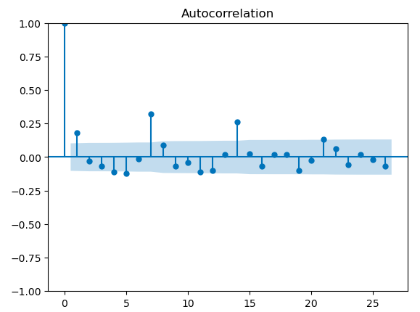
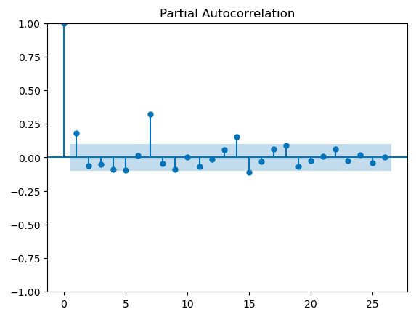
Method:
Exploratory data analysis.
Seasonal Autoregressive Integrated Moving Average + Exogenous Variables (SARIMAX) model.
Performed Augmented Dickey-Fuller (ADF), Autocorrelation Function (ACF) and Partial Autocorrelation Function (PACF)

Slide 7
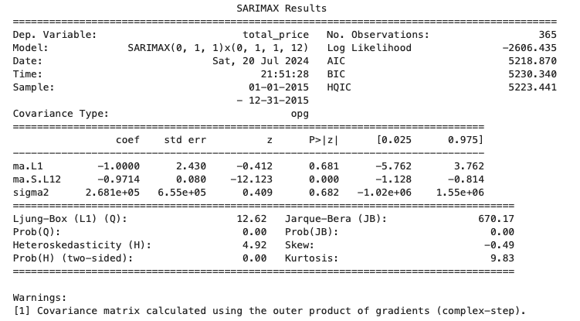
Results: Part One

Slide 8
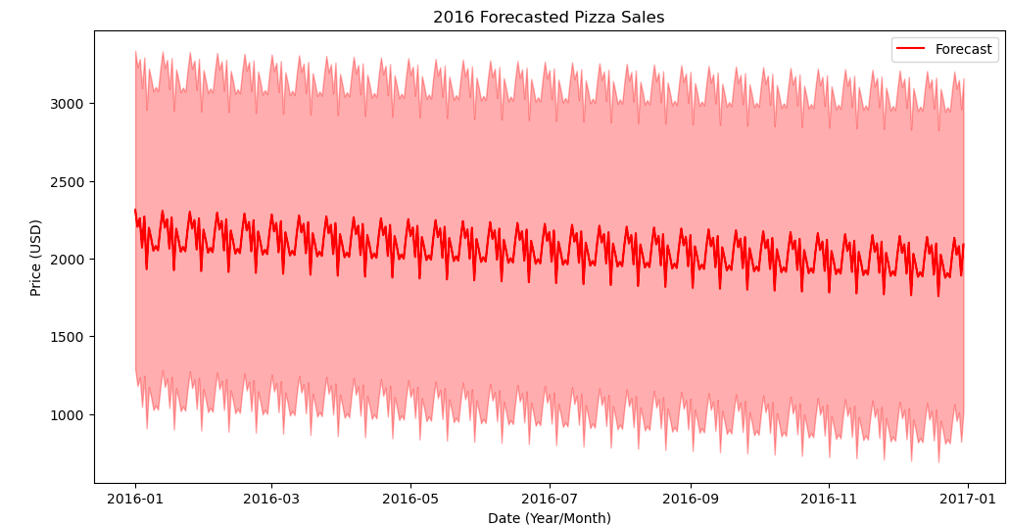
Results: Part Two

Slide 9
Conclusion:
Will give business owners a starting point but more work certainly needs to be done.
Dataset may not be right for the model.
I desire stronger results than the ones given.

Slide 10
References:
Mdismielhossenabir. “Pizza Sales Dataset.” Kaggle, Kaggle, 10 Jan. 2024, www.kaggle.com/code/mdismielhossenabir/pizza-sales-dataset.
Krimmel, Matthew. “Why Do Restaurants Fail? Restaurant Failure Rate Statistics.” Complete Bar Inventory Software System, 10 July 2024, home.binwise.com/blog/restaurant-failure-rate.

